Slide 1
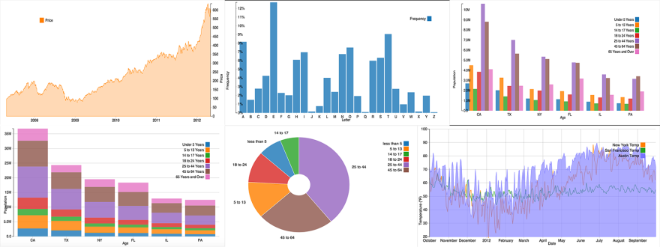
Cloud-based Service Platform for Near Real-time Analysis and Prediction of Manufacturing Plant Situation Awareness (MSAW)
Sensor data management module
AI Engine for PSAW
Service management module
Sensor data database
AI model database
(MEBN/SSBNs)
Management Database
Processing for big data
Machine learning/reasoning
Visualization/Service control
Provides sensor data
Provides estimation/prediction
Company 1
Company 2
…
Company N
Service management

